Slide 1

NICE Challenge Project
The Workforce Experience Before the Workforce
Dr. Vincent Nestler, Dr. Tony Coulson, & James Ashley
NICE Challenge Project @ CSUSB

Slide 3
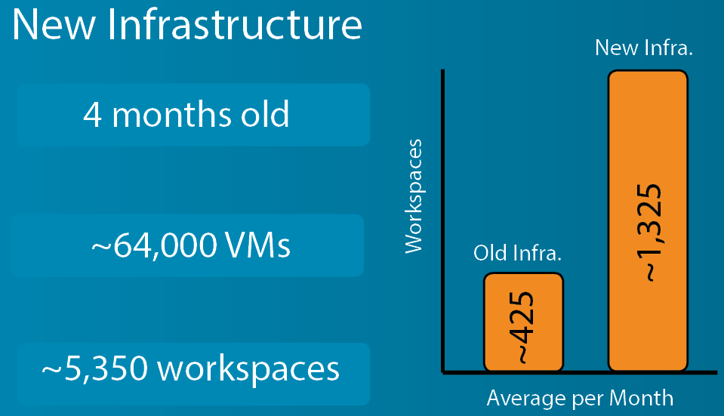
Infrastructure Upgrade
-----------
Protect and Defend
15 New Challenges - All from Protect & Defend
Some Examples…
Malware Aftermath Cleanup
Configuration Management Gone Awry
Sniffing Out Suspicious Activity
A completely new environment all for P&D!

Slide 4
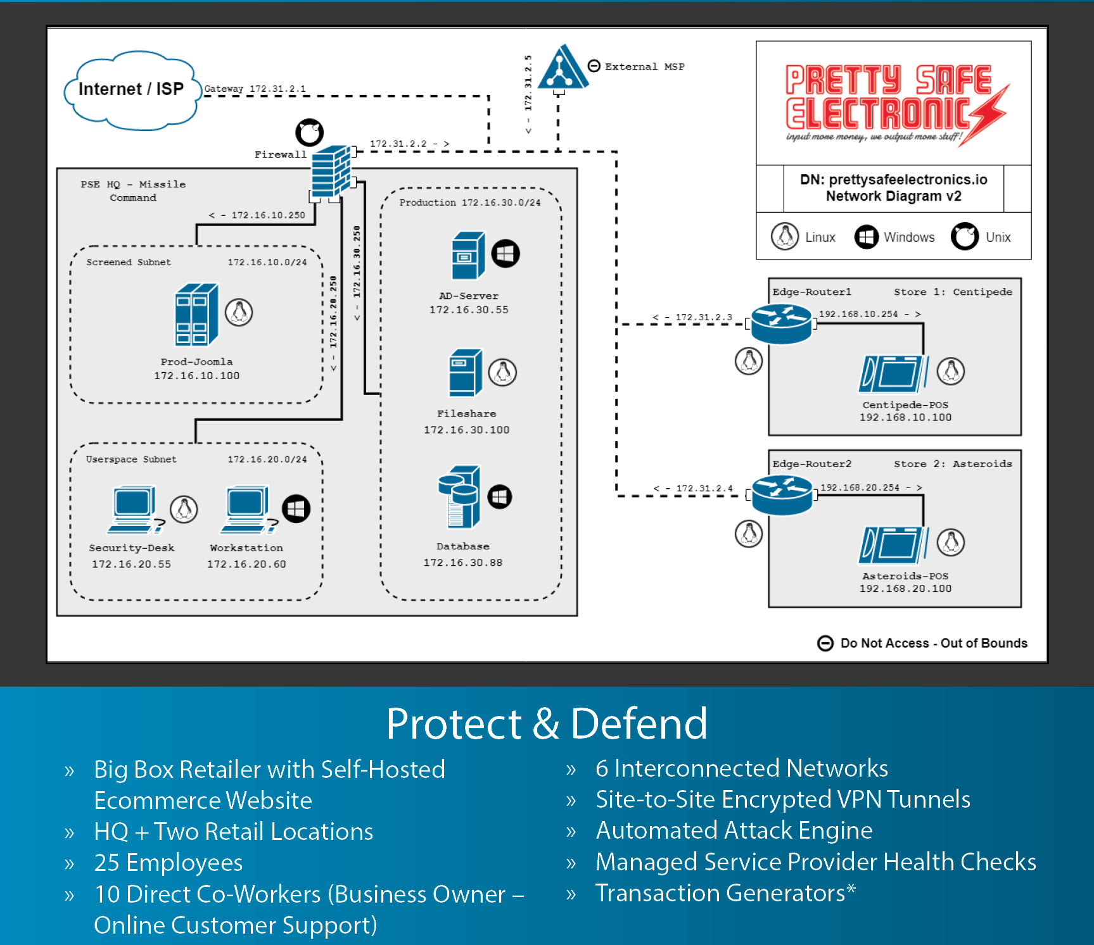

Slide 5
Who and what is all that content and hardware for?
For…
200+ Universities/Community Colleges
300+ Curators (Professors/EDU Staff)
To Deploy…
80+ Unique Challenges
From and Mapped Against…
Operate & Maintain, Protect & Defend, Investigate, and the CAE KUs
Used As…
Assessments, Course Work, CCDC & NCL Preparation, Capstones, Etc

Slide 6

Live Demo

Slide 7
What is coming?
Continued WebPortal UI Updates
More Protect & Defend Challenges
Curator Comments on Submissions to Players
Deeper Data Layers for Challenge Submissions
LMS Integration

Slide 8
How do you get access and get started? nice-challenge.com

Slide 9
Contact Us
James Ashley III – jashley@nice-challenge.com
Dr. Vincent Nestler – vnestler@csusb.edu
Dr. Tony Coulson – tcoulson@csusb.edu
NICE Challenge Project – www.nice-challenge.com

