Slide 1
National Cyber Summit Huntsville, AL
Renee P. Wynn
NASA Chief Information Officer
June 6, 2018

Slide 2
Our Founding Directive
51 U.S.C. 20112(a)(3) - includes as one of the functions of the administration “provide for the widest practicable and appropriate dissemination of information concerning its activities and the results thereof”
51 U.S.C. 20132 - provides that “[t]he Administrator shall establish such security requirements, restrictions, and safeguards as the Administrator deems necessary in the interest of the national security”

Slide 3
How NASA’s Newest Planet Hunter Scans the Sky
TESS, the Transiting Exoplanet Survey Satellite, is NASA's newest exoplanet mission. TESS will find thousands of new planets orbiting nearby stars.
https://www.youtube.com/watch?v=evHF_mnIdj4
2

Slide 4
NASA’s Global Footprint: Space Networks
Human Spaceflight Missions
Sub-Orbital Missions
Earth Science Missions
Space Science Missions
Lunar Missions
Solar System Exploration

Slide 5
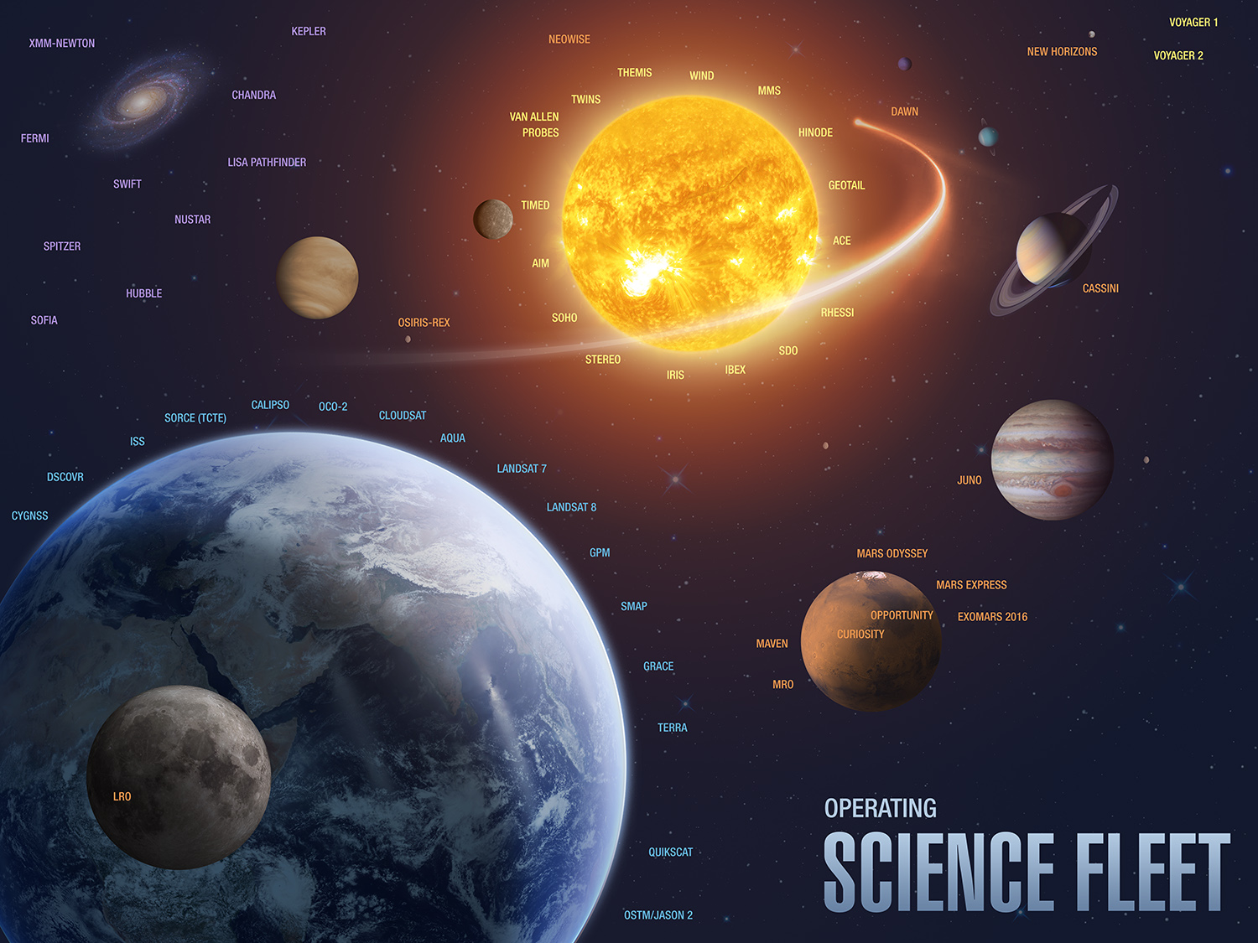
NASA’s Global Footprint: Space Networks

Slide 6
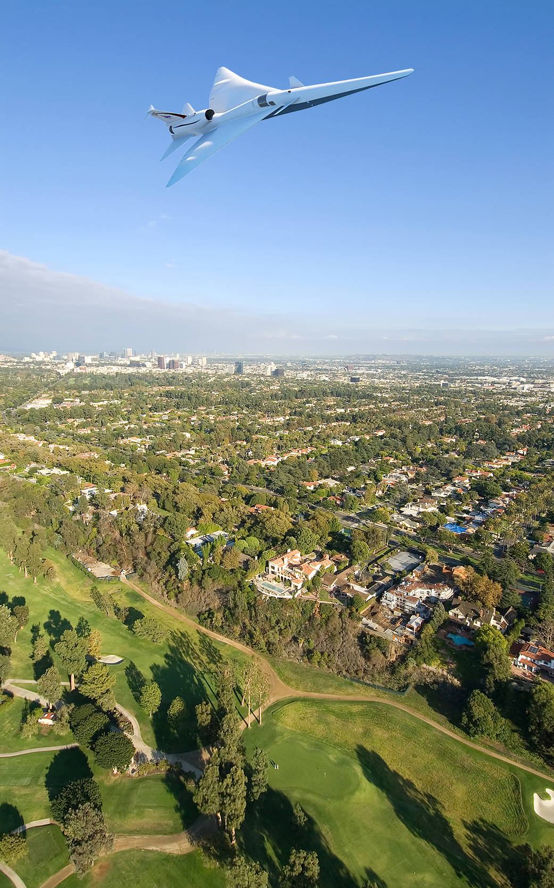
Low-Boom Flight Demonstrator (X-Plane)
Notes:
NASA’s work has always strengthened our national security and the economy, and our ongoing research and testing of new aeronautics technologies is critical in these areas. It will help us lead the world in a global aviation economy with increasing benefits worldwide. IT is supporting NASA’s goal to improve air traffic management, make progress integrating unmanned systems into the airspace, and fund an experimental supersonic Xplane and increase hypersonic research. NASA's aeronautical innovators are leading a government-industry team to collect data that could make supersonic flight over land possible, dramatically reducing travel time in the United States or anywhere in the world.

