Slide 1
Oligodontia

Slide 2
Oligodontia definition
There is no official classification for missing teeth.
In today article the patient is missing 8 teeth
Hypodontia : the most common term, it is often used to describe every condition, including the absence of all teeth (anodontia)
Mild 1 to 2 teeth
Moderate 3 to 5 teeth
Severe more than 6 teeth

Slide 3
Oligodontia definition
Oligodontia has been proposed for describing the absence of a larger number of teeth
This number following the hypodontia classification is fixed to 6 teeth
Oligodontia has been further divided by other author between syndromic and non syndromic
Isolated hypodontia/oligodontia (non syndromic)
syndromic hypodontia/ oligodontia
There is also geographic variation
oligodontia is more often used in Europe
Agenesis is more often used in U.S
When reading a transfer file or a publication be careful with those term if they are not precisely defined as they can reflect different reality

Slide 4
Oligodontia Prevalence primary dentition
Low incidence between 0.1-0.9% of the population
Equal distribution between male and female
More frequent in the anterior maxilla, the lateral incisor are the element most frequently missing
Often associated with hypodontia of the permanent dentition
Hypodontia is often associated with syndromic condition
consequently missing lacteal teeth must not be dismissed has being not important

Slide 5
Oligodontia Prevalence permanent dentition
The distribution vary with different population
Agenesis are more frequent with women, the ratio is quite constant between different population at 1.3-1.4
Those two factor indicate that there is probably a strong genetic influence to agenesis

Slide 6
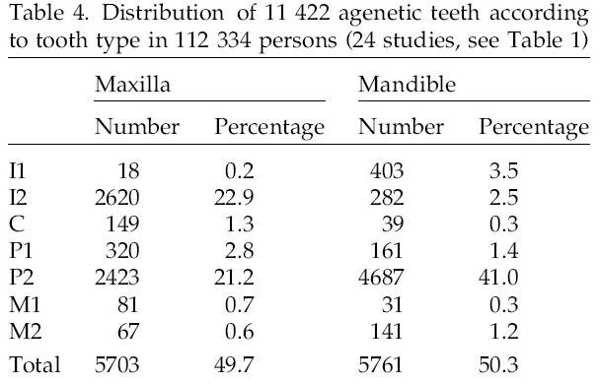
Oligodontia Prevalence permanent dentition
The teeth the more often implicated are in decreasing order
Mandibular second premolar 3%
Maxillary lateral incisor 1.7%
Maxillary second premolar 1.5%
Mandibular central incisor 0.3 %
Mandibular lateral incisor and maxillary first premolar 0.2%
Mandibular second molar and maxillary canine
The trend is of course that the more distal element of each group is the one that will have the more chance of being absent

Slide 7
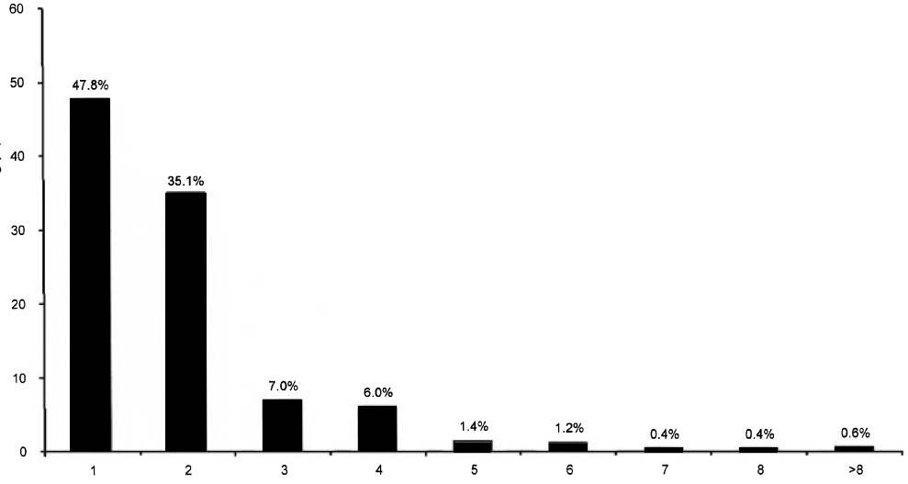
Oligodontia Prevalence permanent dentition
In case of hypodontia :
1 to 2 teeth missing 83%
3 to 5 teeth missing 14.4%
6 and more teeth missing 2.6 % or 0.14% of the general population

Slide 8
Oligodontia Prevalence permanent dentition
When a teeth is missing it will be bilaterally
For the maxillary central incisor in 54% it is the only teeth that has more than on chance in two to be bilaterally missing
The second maxillary premolar 49.25%
The second mandibular premolar 45.6%
The mandibular second incisor 41.2%
When two teeth are missing we are thinking agenesis and when only one is missing we think accident or tooth decay.
But in fact agenesis of only one dental element is the most frequent case

Slide 9
Oligodontia Aetiology
Occasionally can be associated with environmental factor but the main etiology is genetic
The genetic basis is not well understood but hypodontia is frequently identified as a familial trait
The presence of hypodontia in individual without family history suggest that it can happen as the result of a spontaneous genetic mutation
Hypodontia is linked to small teeth size which suggest that it is part of a continuum. under a certain size teeth germ will not develop themself leading to a missing teeth.

Slide 10
Oligodontia Aetiology
Hypodontia is associated to syndromic condition :
Hypohidrotic ectodermal dysplasia 1 (HED) and 3 (EDA3)
Incontinentia pigmenti (bloch-Sulzberger syndrome)
Cleft lip/palate- ectodermal dysplasia syndrome
Witkops syndrome (tooth and nail syndrome)
van der Woude syndrome (lip-pit syndrome)
Oral-facial-digital syndrome (OFD)
Rieger syndrome
Down syndrome
Book syndrome
Holoprosencephaly

Slide 11
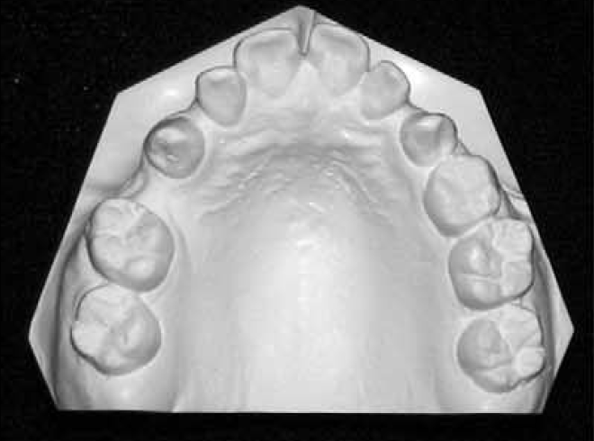
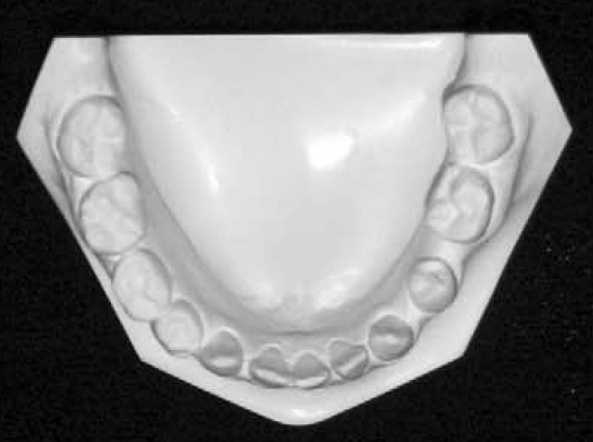
Oligodontia Features microdontia
Microdontia : characterised by smaller than normal teeth
Abnormal shape is also frequent
Crown : tendency to paralle side or inclined toward the occlusal table
Root : shorter than usual and abnormal form
There is a lack of dental tissue
All or only some of the teeth can be affected with varying degree
Microdont teeth present a reduce surface area of enamel, that can be problematic for reconstructive technics
Because of the combination of missing teeth and reduce size of the remaining element there is discrepency between the skeletal base and the dental base

Slide 12
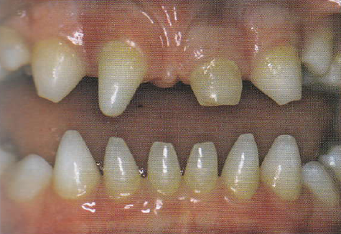
Oligodontia Features Conical teeth
As microdontia can affect one or several teeth
As with microdontia can be genetically determined but can also have systemic or local causes
In case of conical teeth two problem must be address
it is highly non esthetic
can lead to trauma
The point can be remove to avoid trauma , but care must be taken as there is a very narrow pulp
Restorative material or overdenture can be used

Slide 13
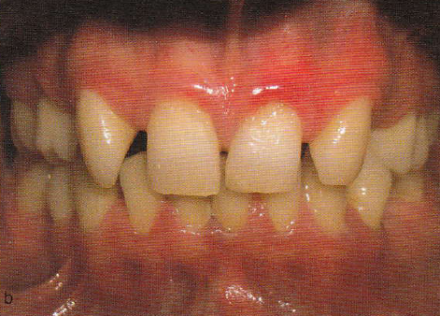
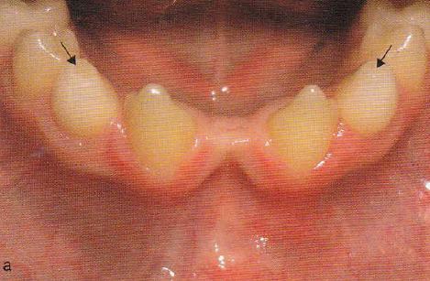
Oligodontia Ectopic eruption
Ectopic eruption of permanent teeth is common in hypodontia and is probably caused both by the lack of adjacent teeth to guide the eruptive process and of spaces in which they may erupt
This can lead to esthetic and functional problem
This can usually be corrected (but not always) with orthodontic treatment and surgical exposure if necessary
A classic case is the eruption and migration of the maxillary canine mesially when the incisor are missing
In this case the permanent mandibular canine erupted in place of the incisors

Slide 14
Oligodontia Retained primary teeth
Delayed eruption of permanent teeth is a feature of hypodontia
If the permanent successor is missing, primary teeth can be retained for long time, sometime even in the fourth and fifth decade
If the permanent successor is not present the primary teeth still have high chance to undergoing root resorption
But the rate of resorption will be variable depending of the teeth, age and patient

Slide 15
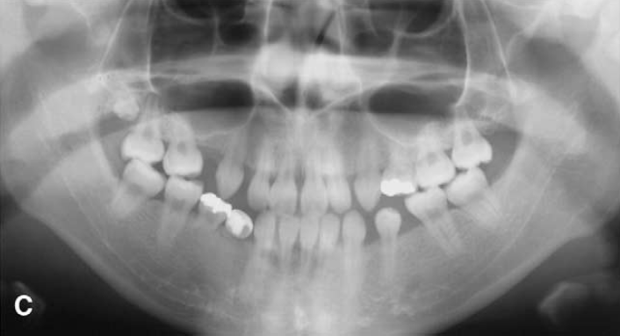
Oligodontia Retained primary teeth
Canine
Up to age 35, 60-80% have minimal root resorption
20-40% less than half the root resorbed
After 35 years the root resorption is likely to increase
Primary molar
up to age 12 20% have minimal resorption and 80% have more than half the root resorbed
Secondary molar
Up to age 24 40-60% have minimal root resorption the rest will have less than 50% root resorption
When doing the treatment planning keep in mind that even if at the present time there is no root resorption on a lacteal teeth root resorption will happen with time
In this patient case (15 years old)
The root of 84 is almost entirely resorbed
85 root more than half
65 root is almost intact

Slide 16
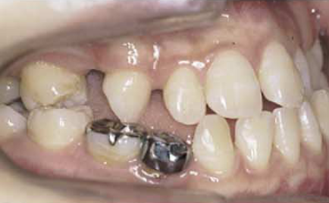
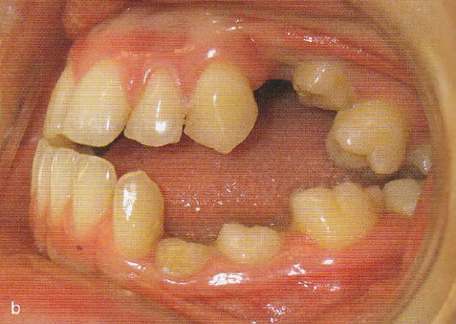
Oligodontia Retained primary teeth
Retained teeth can give satisfactory service for many year
The descision to extract or not must be based on case by case basis
The most common trouble are :
loss of dental tissue resulting in unesthetic appearance and supra occlusion of the adjacent
Retained primary teeth frequently become ankylosed and consequently infra-occluded
The ankylos lead to a failure of developement of the alveolar process
Severly infra occluded teeth can be difficulte to removed and will lead to further loss of alveolar bone

Slide 17
Oligodontia Ankylosis
Ankylosis is an anatomical fusion between cementum and alveolar bone
It prevents the normal compensatory eruptive mechanism that maintains the level of the occlusal plane during continued vertical skeletal development
Without compensatory mechanism an ankylosed tooth became infra-occluded
The seems to be a genetic component to the condition as if a child is touch by the condition, the sibling have a high probability of being touch also
The prevalence have been reported to be between 1.3% to 8.9%
Their seems to have a higher prevalence in subject with hypodontia suggesting a common mechanism

Slide 18
Oligodontia Ankylosis
Feature | Consequence
Infra-occluded primary molar | Delayed exfoliation Progressive infra –occlusion Difficulty with extraction
Permanent successor | Delayed eruption or impaction Abnormal eruption pattern Disturbed root development Rotation of successor Cyst formation
Developing occlusion | Potential site for developing malocclusion Midline shift Over eruption of opposing tooth Tipping of adjacent teeth Localized open bite Reduced vertical alveolar bone development Impaired mastication The condition is also associated with a higher frequency of impacted maxillary canine, ectopic first permanent molars

Slide 19
Oligodontia Ankylosis
QUIZ
How do you determined if a teeth is ankylosed ?

Slide 20
Oligodontia Ankylosis
1 looking for a step in the occlusal plan
It is not sufficient for making a diagnosis, as the crown of the primary is shorter than that of the permanent

Slide 21
Oligodontia Ankylosis
2 Percussion :
Not reliable at least 20% of the root surface must be ankylosed before a clear metallic sound can be heard
3 Mobility testing
Not reliable at least 10% of the root surface must be ankylosed before the mobility is affected
4 obliteration of periodontal membrane on a peri-apical film
unreliable as it is a 2D image. The bucco lingual aspect of the root can not be check

Slide 22
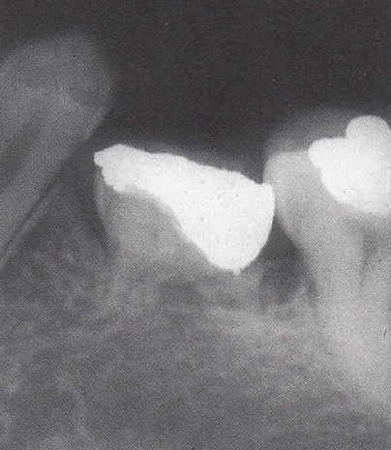
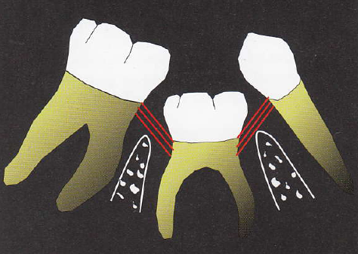
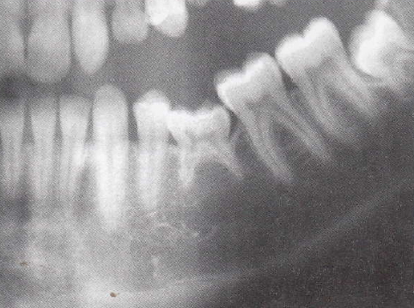
Oligodontia Ankylosis
5 The most reliable indicator of ankylosis in a mildly infra-occluded tooth is the presence of a vertical step in the interproximal bone around the infra occluded molar.
This signifies a cessation of vertical bone formation normally associated with eruption
The tension of the trans gingival fiber is thought to favorise de the version of the adjacent teeth

Slide 23
Oligodontia Ankylosis
So in the case of this patient the X ray told us that their is probably no ankyolsis.

Slide 24
Oligodontia Ankylosis
Any other way to assess ankyolsis ?
3D X-ray can allow to check the totality of the periodontal ligament
Orthodontic treatment : as long as the teeth move during the treatment it is not ankylosed

Slide 25
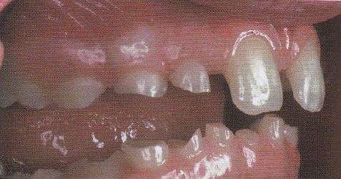
Oligodontia Tooth surface loss
This occur mainly on retained primary teeth due to their composition
Can also affect permanent teeth this is due :
there lesser number which mean that the remaining element will have to support more mechanical stress
Subject with hypodontia are also subject to microdontia, the stress will therefore be more important due to the smaller surface of the occlusal table
Those two factors lead to an increase attrition and abrasion of the teeth which in turn increase stress
Tooth surface loss can lead to an increase in freeway space

Slide 26
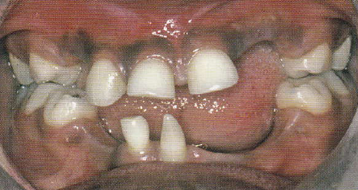
Oligodontia Reduce alveolar development
In case of anodontia the alveolar development will not take place the aspect will be similar to a space with have stay edentulous for some time
In only the primary teeth is present, the development of the alveolar bone will be less because
the stimulus of the larger permanent teeth is not present
the primary will often become ankylosed leading to a stop of the development of alveolar bone
The extraction of the ankylosed element will lead to further loss of alveolar bone
In some individuals with hypodontia, alveolar development is less than normally, even in the presence of permanent teeth
The reduce alveolar development can lead to trouble when orthodontic, prosthodontic or implant are planned
In some case it have to be address prior to those treatment

Slide 27
Oligodontia Increased freeway space
Unusual in hypodontia patient but a study report that 10% of patient referred to a specialist clinic for the management of hypodontia had a clinically determined freeway space of 5-7 mm and a further 4% were in excess of this
Consequently the lower incisor can be not visible in function
The cause are a occlusal plan closer to the alveolar bone than usual
This impact mainly the appearance giving a close configuration pattern
Function and speech can but are rarely impacted
This can be treated with overdenture in young patient
For adult or definitive treatment, implant, bone grapht and surgery can be necessary

Slide 28
Oligodontia Delayed eruption of permanent teeth
This is a recognize feature of hypodontia even if few data exist on the phenomenon
This is of importance when the timing of the treatment is dependent of the eruption of a particular teeth
This also mean that the absence of a teeth must be assessed radiologically

Slide 29
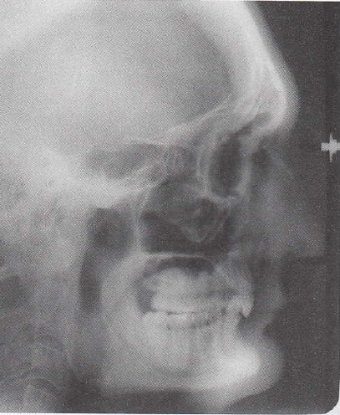
Oligodontia Altered craniofacial morphology
Several study have shown that the craniomorphology of the patient with hypodontia is different from the general population
Different study report :
reduced maxillary and mandibular length
reduced mandibular-cranial base length ratio
Tendency to class III skeletal relationship due to the retrusion of the maxilla and relative prognathism of the mandible
Reduction of the anterior facial height due to forward mandibular growth rotation (FMPA, SNMP)

Slide 30
Oligodontia Soft tissue
The contours of the cheeks is influence by
the teeth
The vertical dimension at rest and occlusion
The lack of posterior teeth lead to a lingual collapse of the cheeck giving an appearance similar to an edentulous patient
An excessive freeway have the same effect, it also lead to an anterior rotation of the mandible in occlusion

Slide 31
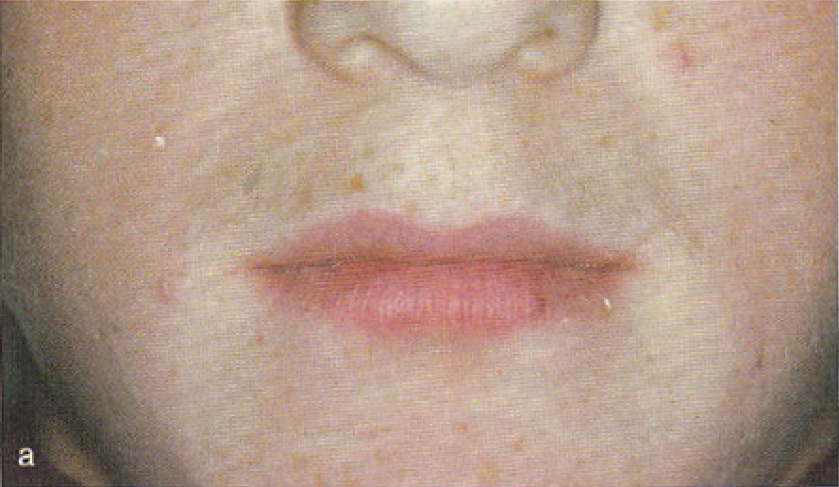
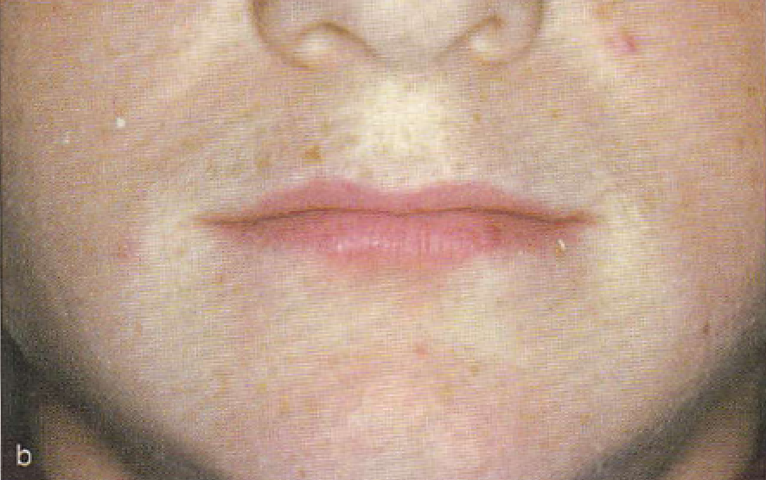
Oligodontia Soft tissue
Patient with large freeway space in repose
In occlusion the lip display and the vertical dimension are markedly reduced

Slide 32
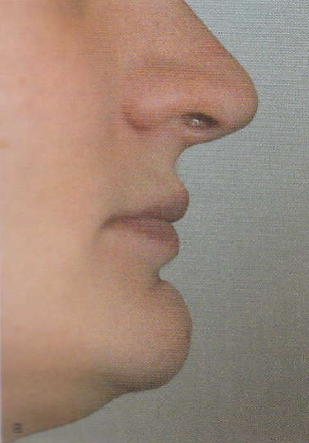
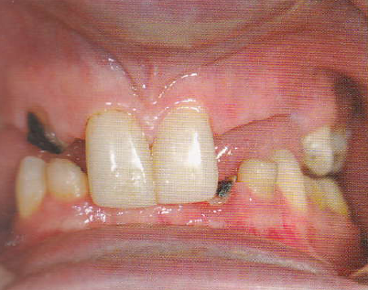
Oligodontia Soft tissue
There is a general lack of dento alveolar tissue
These lead to a deep overbite and reduced OVD
This patient has an excessive freeway space due to lack of posterior support

Slide 33
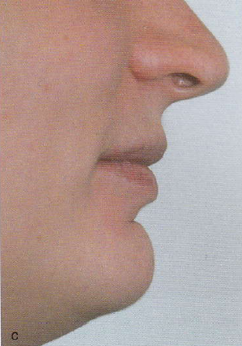
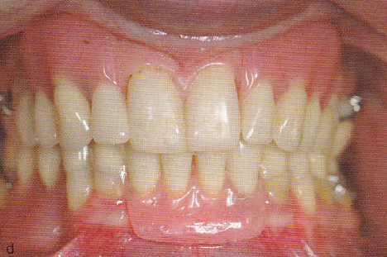
Oligodontia Soft tissue
overdenture were put in place for recreating the lost tissue
There is a very good improvement on the soft tissue

Slide 34
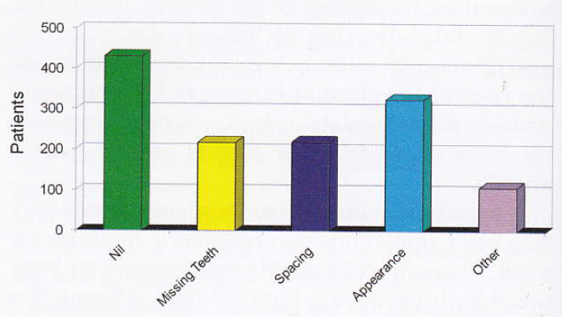
Oligodontia Patient complain
Appearance
appearance of the teeth : microdontial, retained primary teeth, conically shaped tooth, ...
Spacing : can be aggravated by cause non related to hypodontia (such as unfavorable skeletal pattern)
Excessive freeway space : lead to collapsed lower third of the face, thus mimicking the aspect of older patient

Slide 35
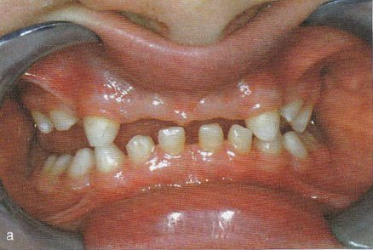
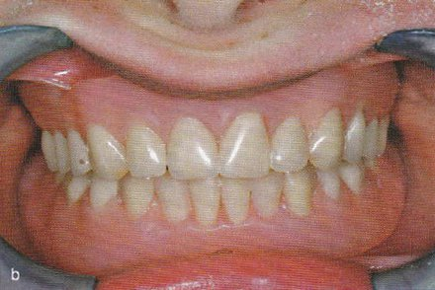
Oligodontia Patient complain
Speech problem : relatively uncommon even if the missing tissue can make the pronunciation of certain word difficult. On exception is during the stage of speech acquisition, in this case an overdenture can help
Difficulty with mastication: Note reported, it is probable as it is reported with edentulous patient. One explanation is that hypodontia patient lack the basis for comparison

Slide 36
Thank you

